Slide 1
Numerical Root Finding
Scientific Programming
By: Abtahi Chowdhury

Slide 2
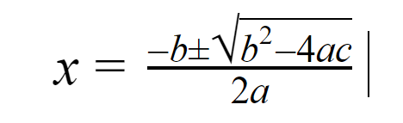
Analytical vs. Numerical
ax²+bx+c=0

Slide 3
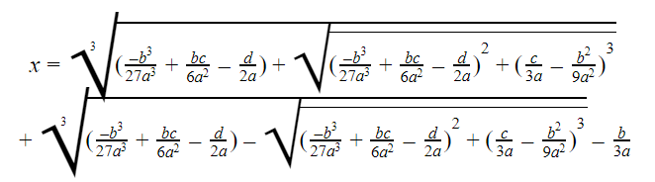
Analytical vs. Numerical
ax³+bx²+cx+d=0

Slide 4
Abel-Ruffini Theorem
Let n ≥ 5. Then there exist a₀, . . . , a^{n−1} in ℂ such that no root in ℂ of the equation x^{n}+a_{n-1}x^{n−1}+· · ·+a₁x+a₀ can be obtained from {0, 1, a₀, . . . , a_{n−1}}, in a finite number of steps, using the operations +, −, · and /, and ()^{1/r} (with choice) for all r ≥ 1 in ℤ.
TLDR: It is impossible to find the roots of a polynomial of degree 5 or higher analytically.

Slide 5
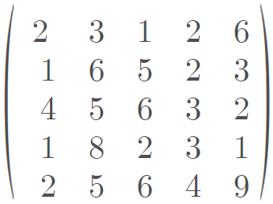
Application of Root Finding - Eigenvalues

Slide 6
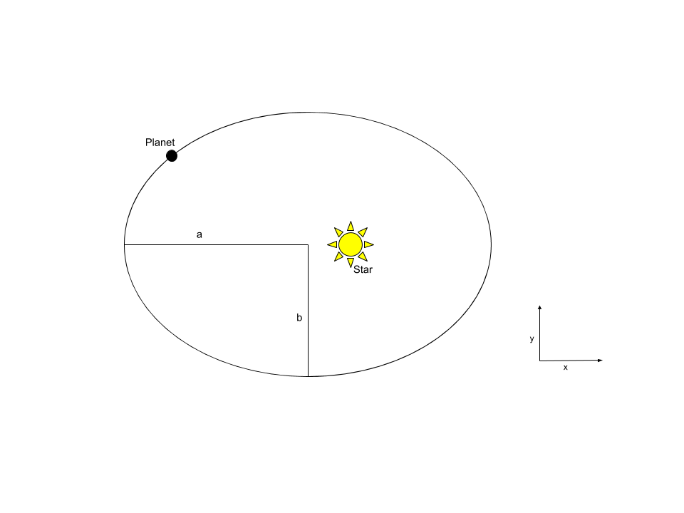
Application of Root Finding - Orbital Motion

Slide 7
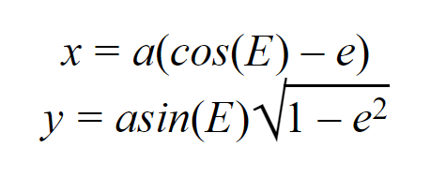
Application of Root Finding - Orbital Motion
a = semi-major axis
e = eccentricity
E = eccentric anomaly

Slide 8
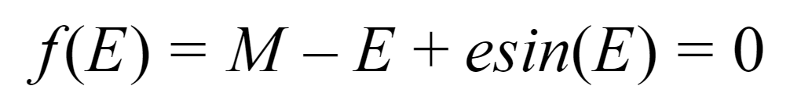
Kepler’s Equation of Motion
M = average anomaly
e = eccentricity
E = eccentric anomaly

Slide 9
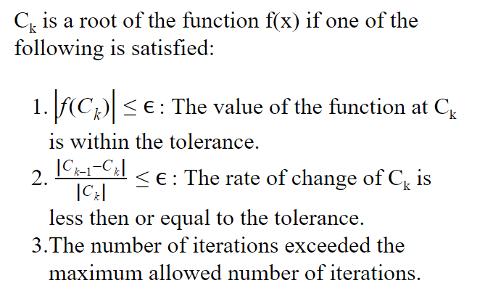
Root Finding Method Criteria

Slide 10
f(x) = (x-3)*(x-1)*(x+1)*(x+3)

Slide 11
Bisection Method
Inputs: f(x) - given function
a,b - initial guesses such that f(a)*f(b) < 0
Algorithm:
Compute c to be the midpoint of a and b
Check if c meets one of the three criteria; return c if yes
If f(c)*f(a) < 0, then b = c, else a = c
Iterate until step 2 is satisfied

Slide 12
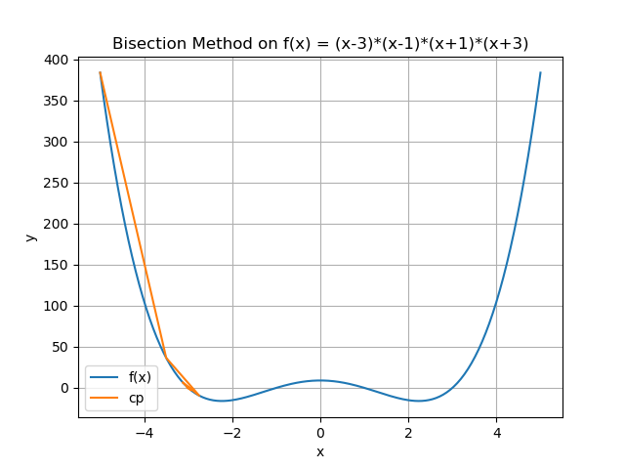
Bisection Method

Slide 13
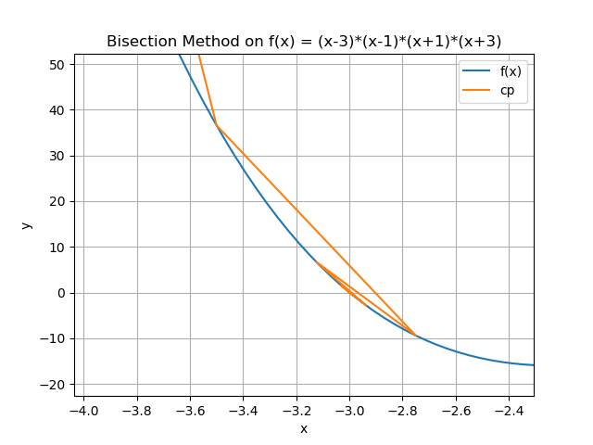
Bisection Method

Slide 14
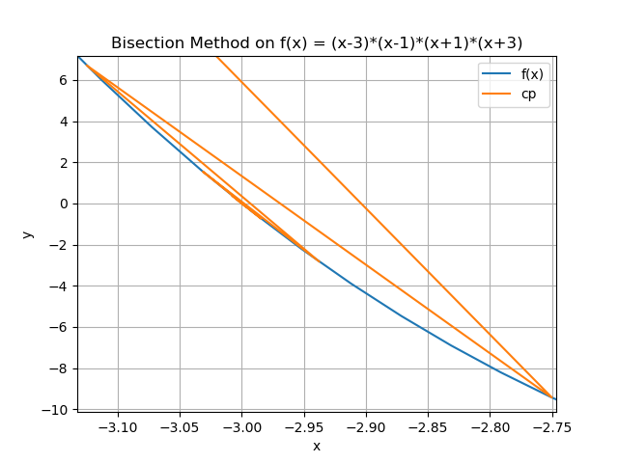
Bisection Method

Slide 15
Bisection Method
0 -3.5
1 -2.75
2 -3.125
3 -2.9375
4 -3.03125
5 -2.984375
6 -3.0078125
7 -2.99609375
8 -3.001953125
9 -2.9990234375
10 -3.00048828125
11 -2.999755859375
12 -3.0001220703125
13 -2.99993896484375
14 -3.000030517578125

Slide 16
Bisection Method
a= | -10 | -100 | -1000 | -10000
root | -3 | -2.999929428 | -3.000009656 | -3.000040397
iterations | 4 | 21 | 25 | 28
time | 0.00198340416 | 0.007001638412 | 0.008001804352 | 0.01000261307
relative error | 0 | 0.002352451986 | 0.0003218640458 | 0.001346550134
a= | -100000 | -1000000 | -10000000 | -100000000
root | -2.999941049 | -2.999947407 | -2.999934655 | -2.999989405
iterations | 31 | 35 | 38 | 41
time | 0.01100230217 | 0.01000142097 | 0.01200389862 | 0.01500272751
relative error | 0.001965067158 | 0.001753132946 | 0.002178216437 | 0.0003531812625
a= | -1000000000 | -10000000000 | -100000000000 | -1000000000000
root | -3.000046266 | -2.999946792 | -3.000000083 | -3.000033389
iterations | 45 | 48 | 51 | 55
time | 0.01300287247 | 0.01600408554 | 0.01700329781 | 0.02000451088
relative error | 0.00154217682 | 0.001773636951 | 2.76E-06 | 0.001112968583

Slide 17
Bisection Method
Always converges but slowly
The interval containing the root must already be known
Certain functions such as x² wouldn’t work at all with this method due to it never being negative

Slide 18
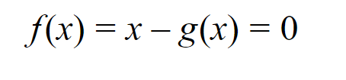
Fixed Point Iteration

Slide 19
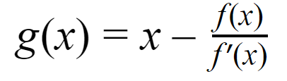
Newton Raphson Method

Slide 20
Newton Raphson Method
Inputs: f(x) - given function
x₀ - initial approximation
Algorithm:
Compute x = x - (f(x)*[f’(x)]⁻¹)
Check if x meets one of the three criteria; return x if yes
Iterate until step 2 is satisfied

Slide 21
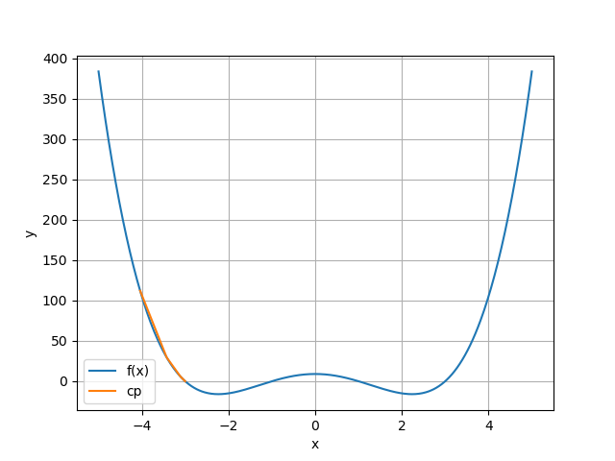
Newton Raphson Method

Slide 22
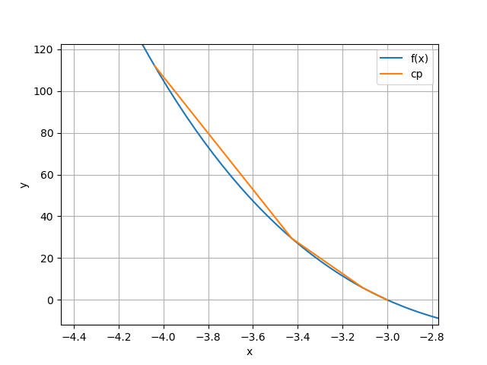
Newton Raphson Method

Slide 23
Newton Raphson Method
0 -5
1 -4.040000056693385
2 -3.4268582431024592
3 -3.1080055696749946
4 -3.0093892686144943
5 -3.000079847237657

Slide 24
Newton Raphson Method
x= | -10 | -100 | -1000 | -10000
root | -3.00000000005691 | -3.00000000020472 | -3.00000000021964 | 3.00000000024131
iterations | 9 | 17 | 25 | 33
time | 0.003000497818 | 0.007001161575 | 0.01000261307 | 0.0130033493
relative error | 1.90E-09 | 6.82E-09 | 7.32E-09 | 8.04E-09
x= | -100000 | -1000000 | -10000000 | -100000000
root | -3.00000000028674 | -3.00000000326349 | -3.00000023247024 | -3.0000000070258
iterations | 41 | 49 | 57 | 53
time | 0.01533603668 | 0.01799988747 | 0.02025341988 | 0.02200484276
relative error | 9.56E-09 | 1.09E-07 | 7.75E-06 | 2.34E-07
x= | -1000000000 | -10000000000 | -100000000000 | -1000000000000
root | Doesn’t Converge | Doesn’t Converge | Doesn’t Converge | Doesn’t Converge

Slide 25
Newton Raphson Method - Flaws
Requires the calculation of the derivative at each iteration
Will fail if f’(x) is 0 in any of the iterations
Will diverge if the initial guess is too far from the actual root

Slide 26
Muller Method
Used to find complex roots of a real equation using real starting approximations
The algorithm involves:
Finding a parabola that pass through 3 initial points
Using the quadratic formula to find the roots of the parabola

Slide 27


Muller Method
Inputs: f(x) - given function
x₀,x₁,x₂, - initial approximations
Algorithm:
Compute f(x₀),f(x₁),f(x₂), and set c = f(x₂)
Solve for a and b
Compute
Check if x₃ meets one of the three criteria; return x₃ if yes
Set x₀=x₁, x₁=x₂, x₂=x₃
Iterate until step 4 is satisfied

Slide 28
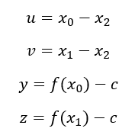
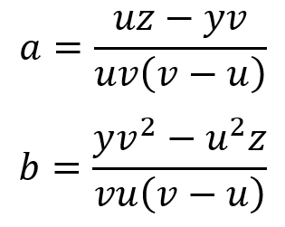
Muller Method

Slide 29
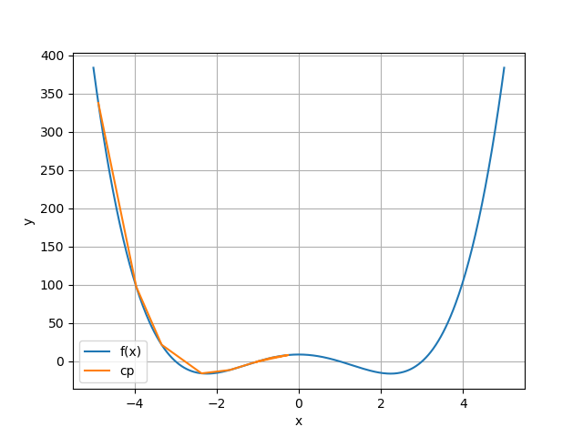
Muller Method

Slide 30
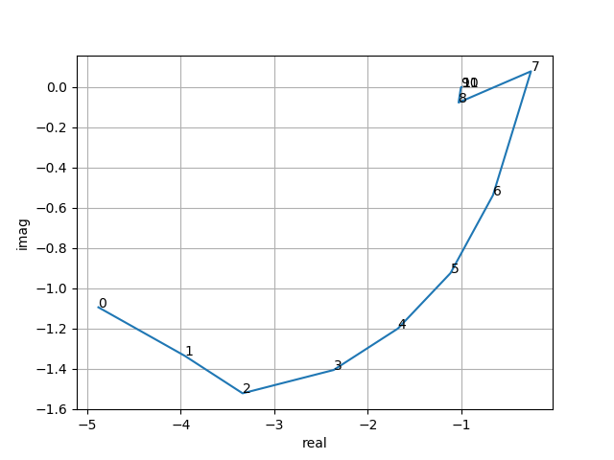
Muller Method

Slide 31
Muller Method
0: (-4.8801261829652995 - 1.094068889451895i)
1: (-3.9566706529640245 - 1.3351344414946014i)
2: (-3.3388169685689615 - 1.5210744789798403i)
3: (-2.3665890086569736 - 1.4055087081225415i)
4: (-1.6788243522145452 - 1.1995094417298326i)
5: (-1.11700430823912 - 0.9244696539350903i)
6: (-0.6625188455214021 - 0.5372172386174486i)
7: (-0.25689626762757883 + 0.07751324640749957i)
8: (-1.030358735150838 - 0.07747564994839862i)
9: (-1.0059793664371621 - 0.0035930528530658673i)
10: (-1.0000252521646738 + 8.601031834495725e-05i)
11: (-1.000000011687454 - 5.982693679519721e-09i)

Slide 32
f(x) = x⁴ + x² + 5

Slide 33
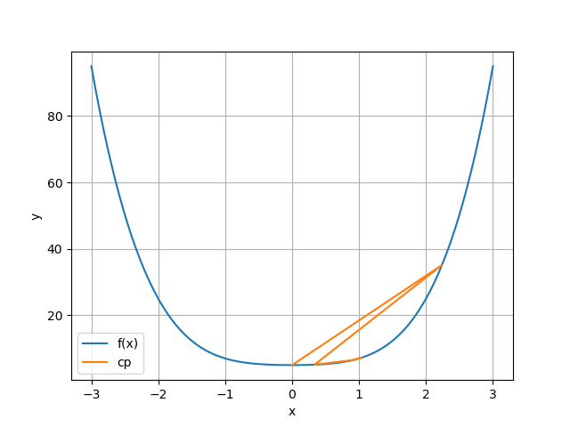
Muller Method

Slide 34
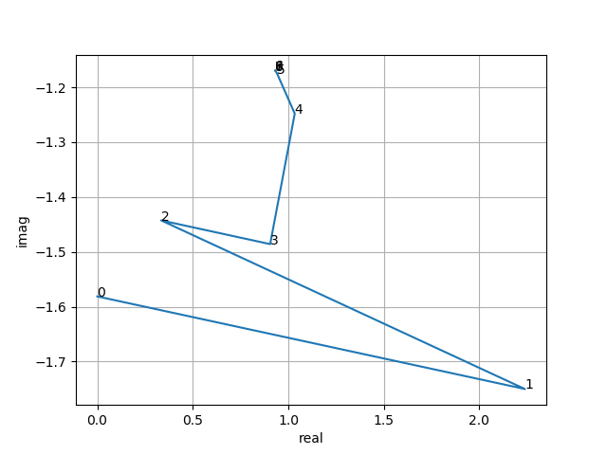
Muller Method

Slide 35
Muller Method
0: - 1.5811388300841898i)
1: (2.2387520178361937 - 1.7499721447155097i)
2: (0.33448804873834237 - 1.442591585492139i)
3: (0.9051495669568861 - 1.4858249715666219i)
4: (1.03388646408585 - 1.2479185215242667i)
5: (0.9417743435854431 - 1.1752114231299944i)
6: (0.9316179197891766 - 1.1694058920608414i)
7: (0.9316835216855865 - 1.1696299753078037i)
8: (0.9316834165906726 - 1.1696298511710068i)

Slide 36
Muller Method - Flaws
Can compute complex roots from non-complex guesses
Will always converge
Requires solving a 2x2 matrix at each iteration
Can be avoided using the formulas mentioned before

Slide 37
Questions

